Slide 1

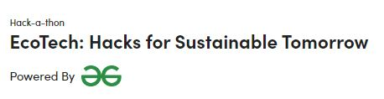
THEME-ECOTECH
PROJECT NAME :AI for a Sustainable Future
DONE BY
S.KRITHIK GOKUL

Slide 2
CONTENTS
ABSTRACT
PROBLEM STATEMENT
ALGORITHMS USED
EXISTING SYSTEM
PROPOSED SYSTEM
SOFTWARE REQUIREMENTS
IMPLEMENTATION USING FULL STACK
BLOCK DIAGRAM
ADVANTAGES
APPLICATIONS
FUTURE SCOPE

Slide 3
ABSTRACT
The AI environmental Conservation System is an innovative platform aimed at addressing core facts of environmental conservation. It leverages advanced AI capabilities to continuously monitor and comprehensively analyze a wide range of environmental data, including air quality, water pollution, deforestation rates, and climate patterns. This system empowers individuals, groups, and businesses to adopt sustainable practices through personalized recommendations, educational content, and engaging challenges. By harnessing AI ,this platform seeks to revolutionize environmental preservation and promote sustainable choices for a better, more resilient future.

Slide 4
PROBLEM STATEMENT
Your task is to create an AI-driven system that tackles the core facets of environmental conservation. The system is designed with the advanced capability to continuously monitor and comprehensively analyze a wide range of environmental data , and propagate sustainable behaviors. You're encouraged to craft a new application or enhance existing platforms, aiming to achieve atleast one of the following objectives: Environmental Data Insights: Develop an AI ecosystem that captures, processes, and analyzes diverse environmental data – encompassing air quality, water pollution, deforestation rates, and climate patterns. The system should furnish real-time insights and visualizations for a comprehensive grasp of the environment's present state. Sustainable Practices: Make AI tools that encourage people, groups, and businesses to do things that are good for the environment. These tools could give personalized ideas, helpful lessons, and fun challenges to make it more interesting and easy to be eco-friendly. Let's team up to help our planet by making smart, Earth-friendly choices! By confronting these challenges head-on, your AI system will be at the forefront of environmental preservation, and the propagation of sustainable practices. Join us in this hackathon to pave the way for a more sustainable and resilient future, where AI becomes a driving force for global good.

Slide 5
ALGORITHM USED TECHNIQUES
Machine learning: Machine learning algorithms can be used to train computer models to identify patterns in environmental data. For example, a machine learning algorithm could be trained to identify patterns in satellite imagery to detect deforestation.
Natural language processing: Natural language processing algorithms can be used to understand and extract information from human language. For example, a natural language processing algorithm could be used to extract information about a user's energy usage patterns from their energy bills.
Computer vision: Computer vision algorithms can be used to extract information from images and videos. For example, a computer vision algorithm could be used to identify wildlife species in images from wildlife cameras.

Slide 6
EXISTING SYSTEM
The existing system may involve various environmental monitoring and conservation efforts. It may include disparate data sources , limited automation, and fragmented sustainability initiatives, There may be isolated apps or services focused on specific aspects of environmental data analysis or sustainability promotion.

Slide 7
PROPOSED SYSTEM
To create an AI-driven system that empowers individuals, businesses, and communities to actively participate in environmental conservation and sustainability efforts through data insights and sustainable practices

Slide 8
SOFTWARE REQUIREMENTS
Arduino 1.8-for finding temperature
Python IDE for storing its average and temperature
Java for backend purpose using
HTML using notepad for Web Development

Slide 9
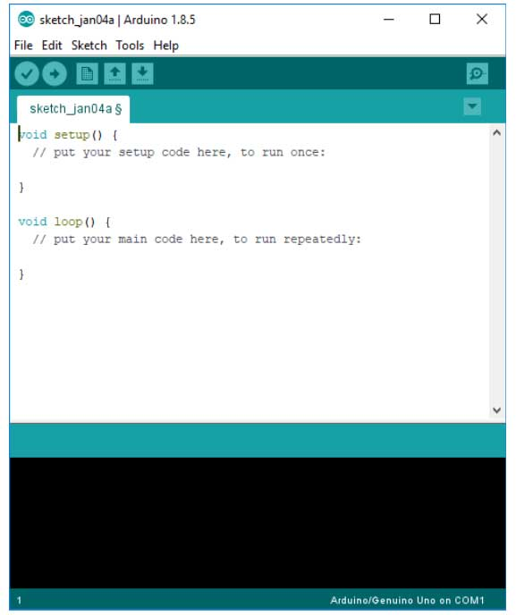
ARDUINO IDE
The Arduino integrated development environment (IDE) is a cross-platform application (for Windows, macOS, Linux) that is written in the programming language Java. It is used to write and upload programs to Arduino board.
Arduino is an open-source electronics platform based on easy-to-use hardware and software. Arduino boards are able to read inputs - light on a sensor, a finger on a button, or a Twitter message - and turn it into an output - activating a motor, turning on an LED, publishing something online. You can tell your board what to do by sending a set of instructions to the microcontroller on the board

Slide 10
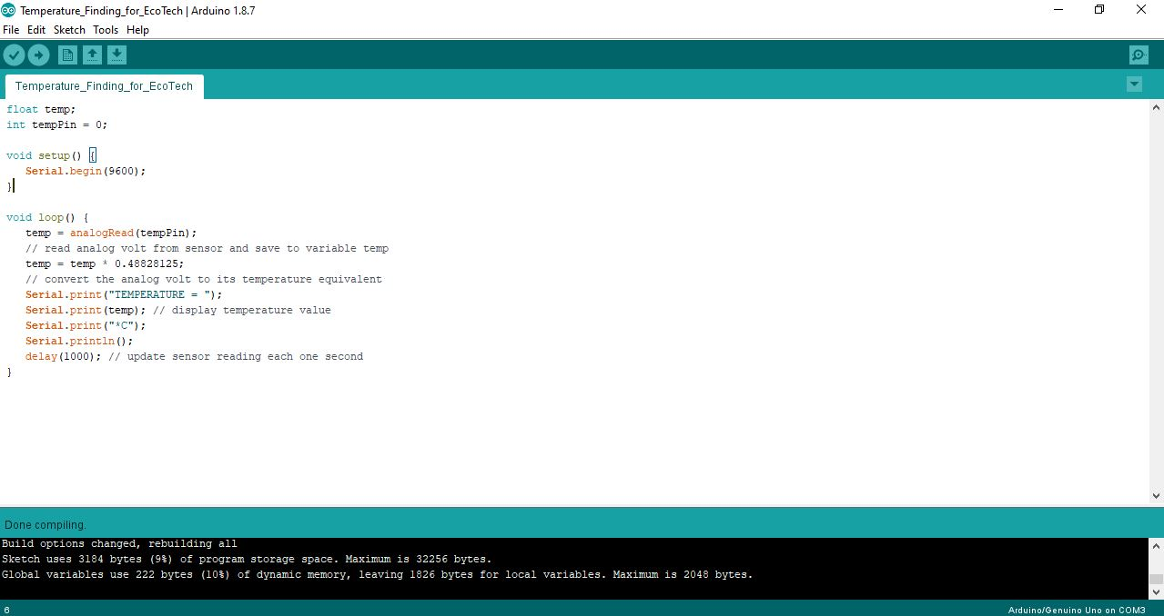
ARDUINO IDE IMPLEMENTATION

Slide 11
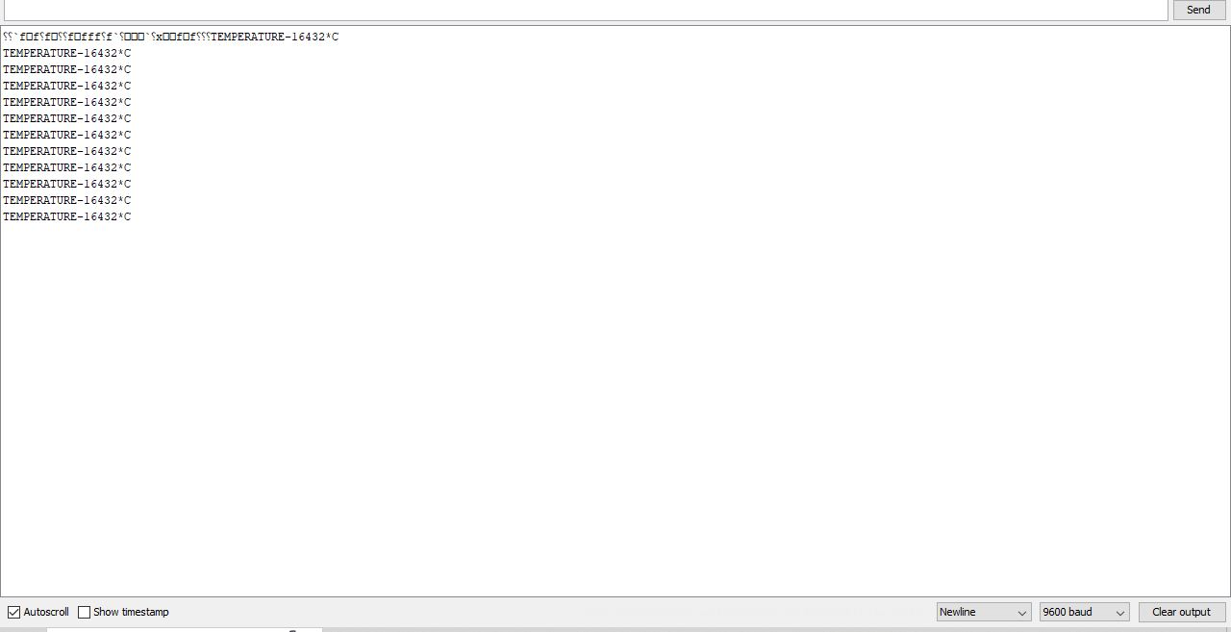
IMPLEMENTATION USING ARDUINO IDE

Slide 12
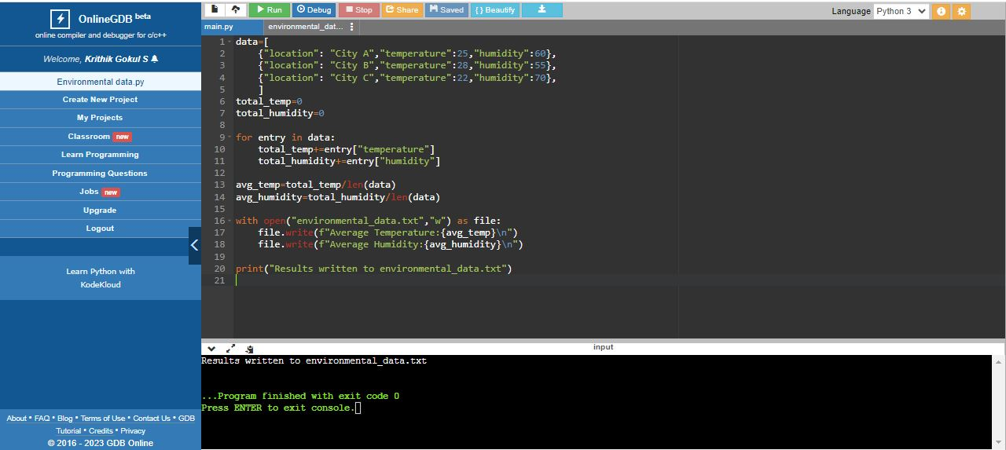
IMPLEMENTATION USING PYTHON

Slide 13
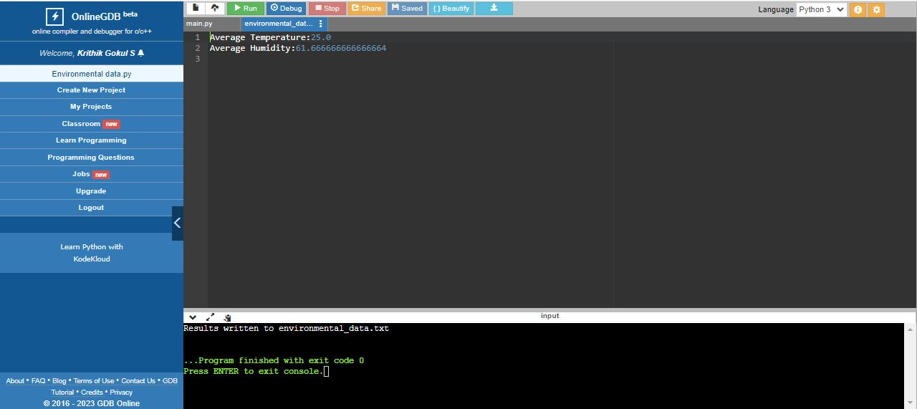
IMPLEMENTATION USING PYTHON[CONTINUED]

Slide 14
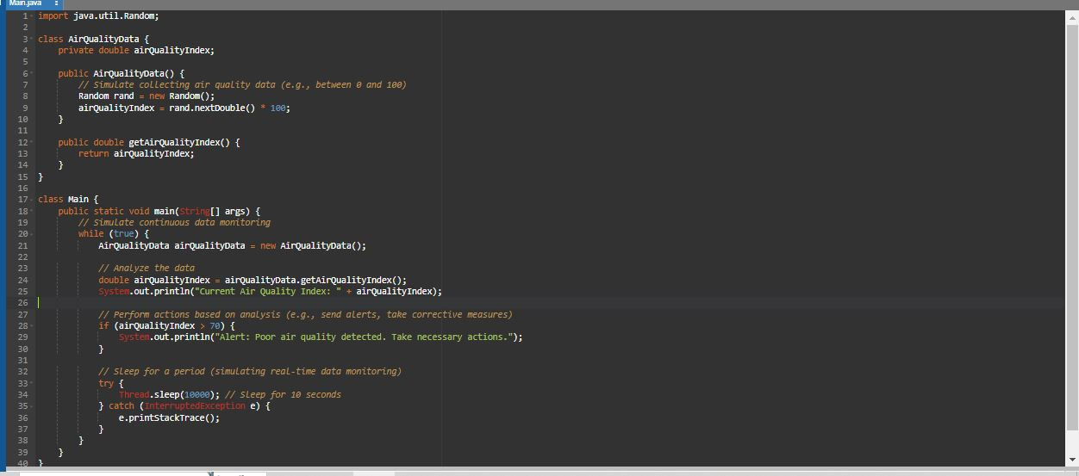
JAVA IMPLEMENTATION RESULTANT

Slide 15
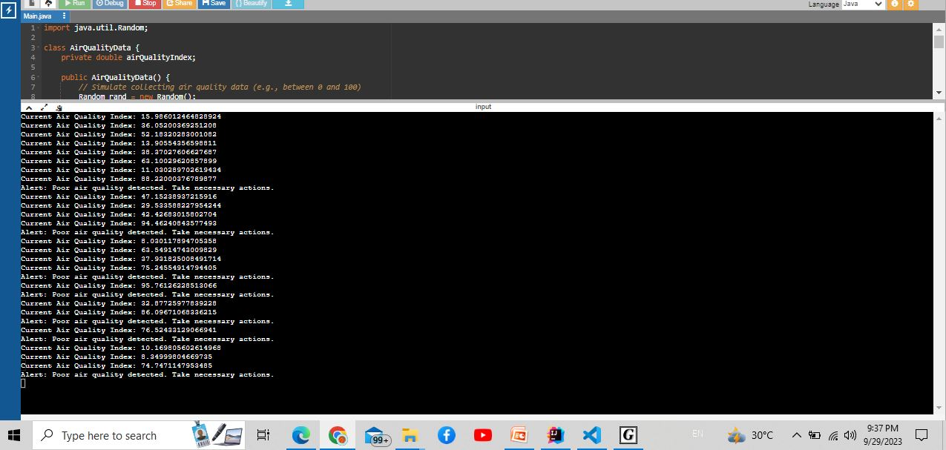
JAVA IMPLEMENTATION OUTPUT

Slide 16
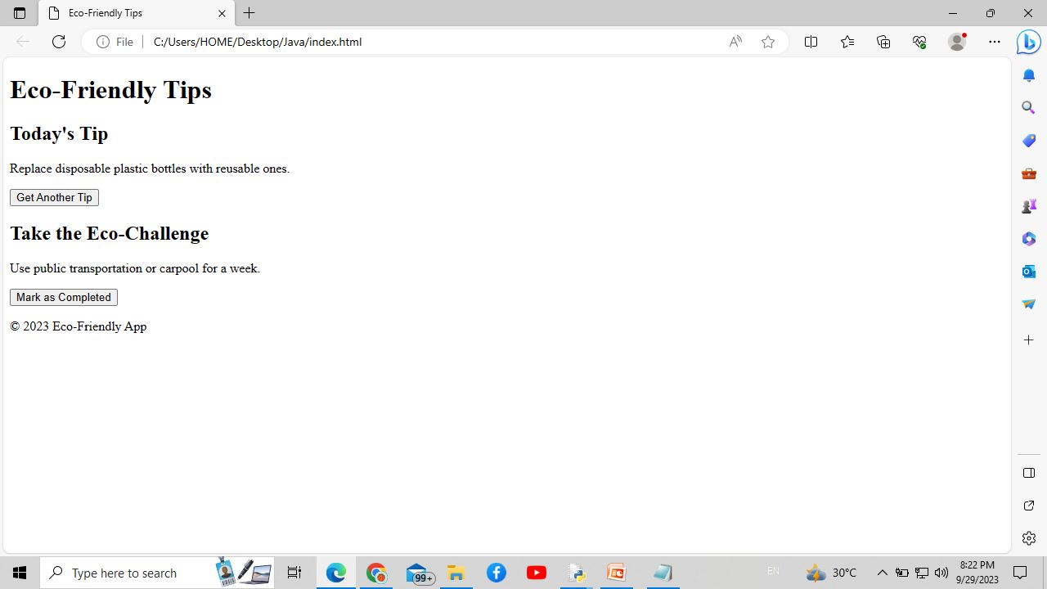
SIMPLE WEB DEVELOPMENT

Slide 17
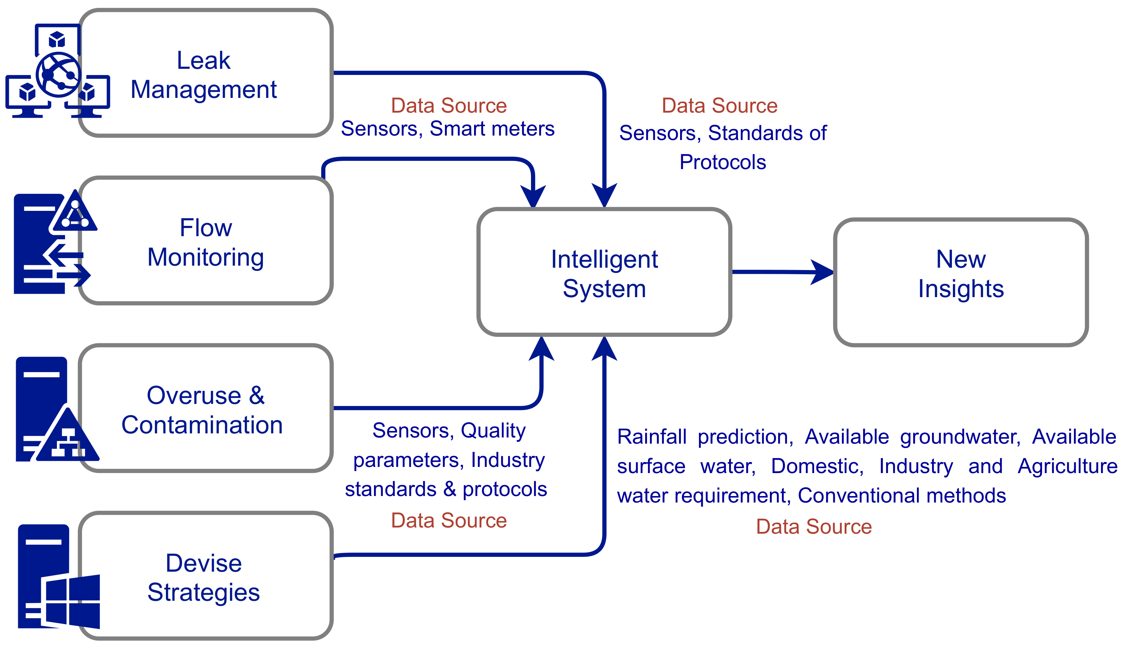
BLOCK DIAGRAM

Slide 18
ADVANTAGES
SCALABILITY
SUSTAINABILITY
ACCURACY
REAL TIME INSIGHTS

Slide 19
APPLICATIONS
ENVIRONMENTAL MONITORING
DISASTER RISK MANAGEMENT
SUSTAINABLE AGRICULTURE
SUSTAINABLE URBAN PLANNING
EDUCATION AND AWARENESS

Slide 20
FUTURE SCOPE
DEEP LEARNING
NATURAL LANGUAGE PROCESSING
REINFORCEMENT LEARNING

Slide 21


